Slide 1

WELCOME AT

Slide 2
WELCOME TO : A world-class skill-development & research institute

Slide 3
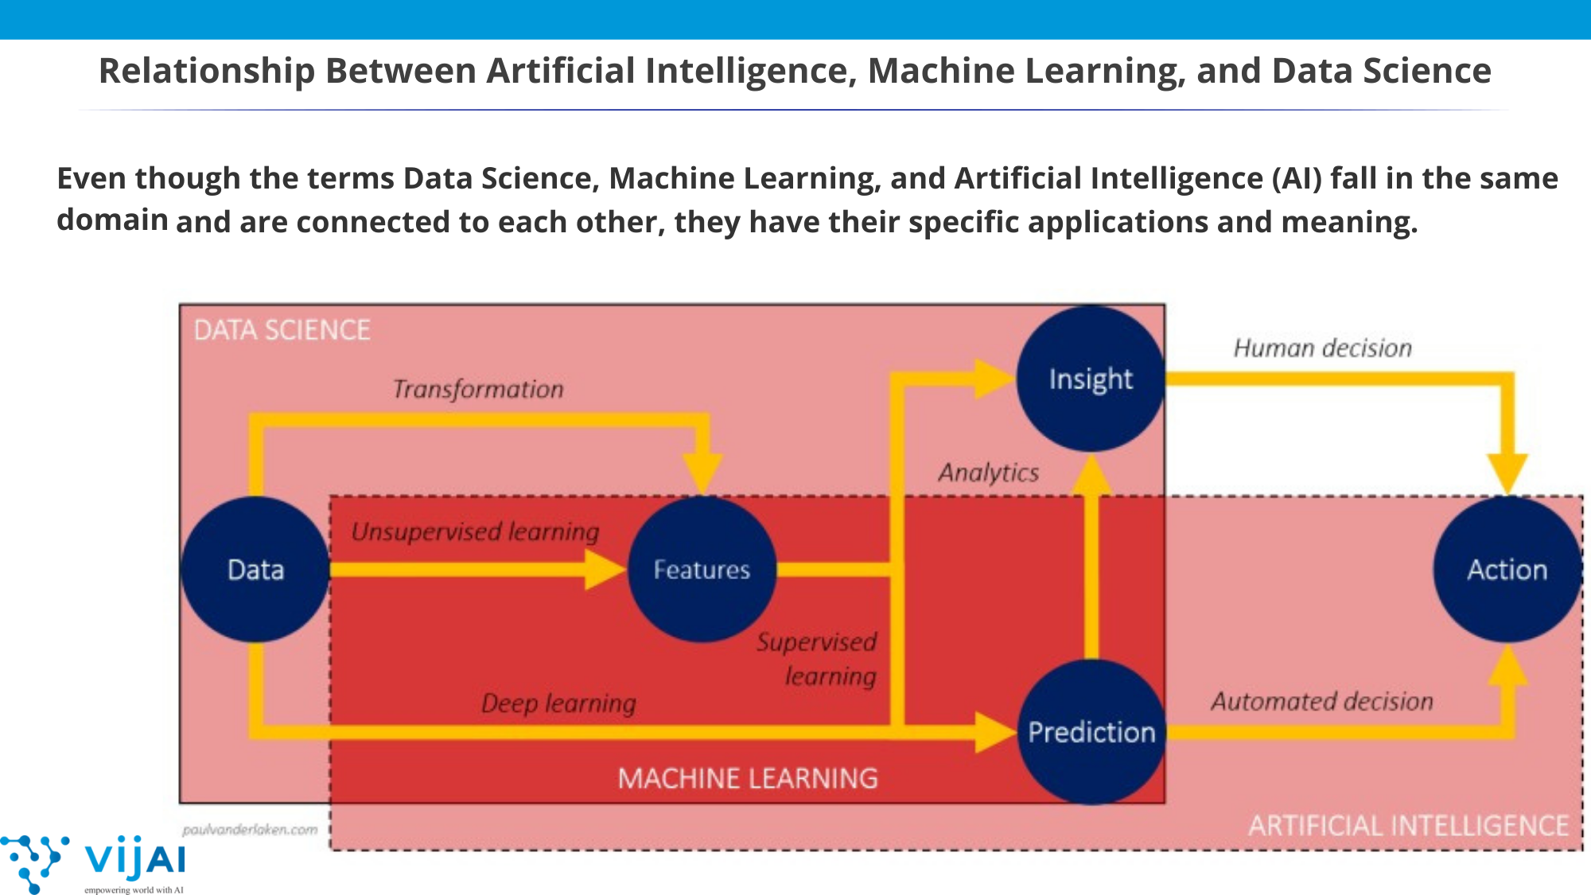

Slide 4

INTRODUCTION TO PYTHON

Slide 5

TOPICS TO BE COVERED
What is Programming and why is it required?
Low-level vs High-level programming languages
Why English is not used as a programming language ?
What is Python ?
Compiler vs Interpreter
Why learn Python?
Features of Python
IDEs and Related Terminologies
Installing Anaconda and using Jupyter Notebook

Slide 6

WHAT IS PROGRAMMING ?
Like we use Hindi or English etc languages to communicate to each other, likewise we use programming languages to communicate and make the computer perform tasks.

Slide 7

Why is Programming required?

Slide 8
History of Python
Source : wikipedia

Slide 9
Father of Python
Guido van Rossum began working on Python in the late 1980s as a successor to the ABC programming language and first released it in 1991 as Python 0.9.0. Python 2.0 was released in 2000. Python 3.0, released in 2008, .

Slide 10
Python Characteristics
Python is a high-level general-purpose programming language. Its design philosophy emphasizes code readability with the use of significant indentation via the off-side rule.

Slide 11
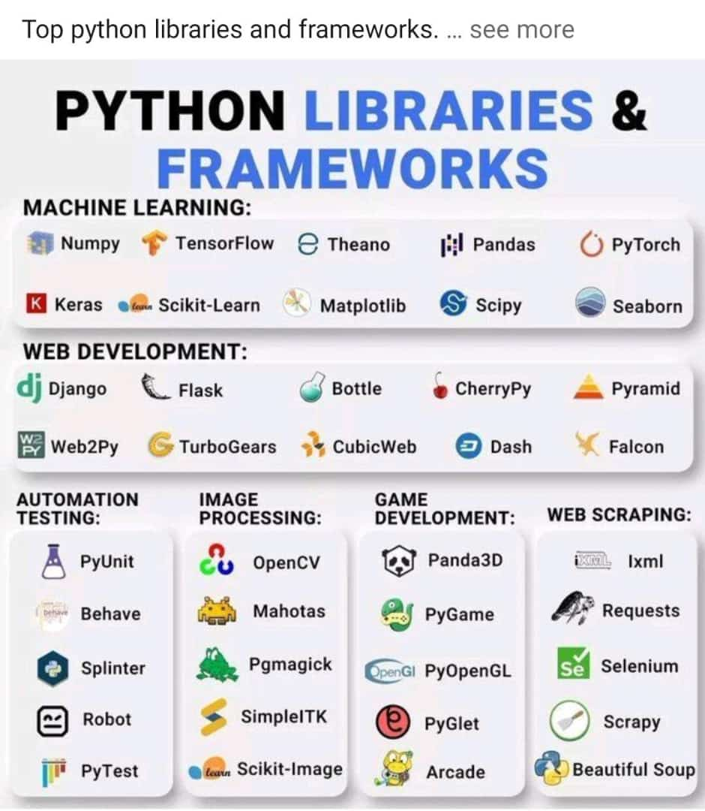

Slide 12
High Level General Purpose
In computer software, a general-purpose programming language (GPL) is a programming language for building software in a wide variety of application domains. Conversely, a domain-specific programming language (DSL) is used within a specific area. For example, Python is a GPL, while SQL and HTML are DSL for querying RDBMS.

Slide 13
Dynamically Typed
For this category of programming languages, there’s no requirement to explicitly state the data type during variable declarations. The language system is able to detect the type of a variable at runtime.

Slide 14
High-Level Programming Language
Low-Level Programming Language
Easy for humans to read , write and modify
Needs to be translated into machine code.
No understanding of how hardware components work is needed
Eg - Python , C , C++ etc
Hard for humans to read , write and modify
Does not need to be translated.
Good understanding of how hardware components work is needed
Eg - Assembly language
and machine code

Slide 15
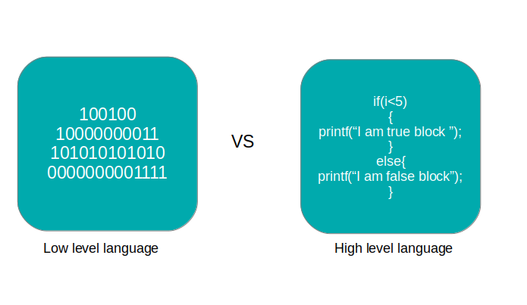
EXAMPLE

Slide 16
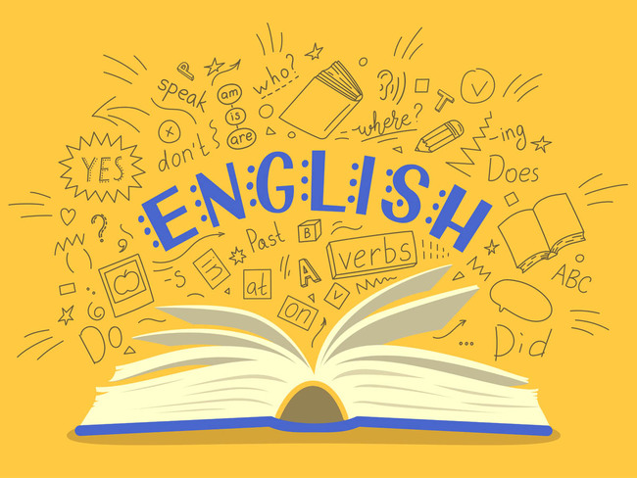
Why English is not used as a Programming Language?
Ambiguous
Can’t solve a mathematical problem
Difficult Grammar

Slide 17
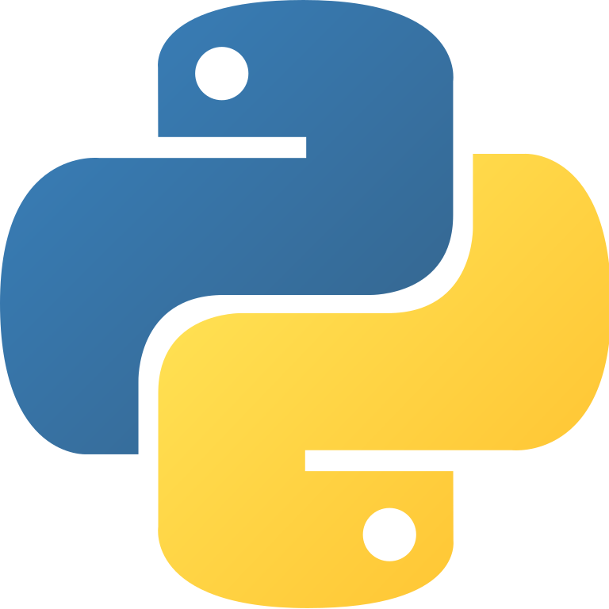
WHAT IS PYTHON?
Python is a general purpose , high-level ,both compiled and interpreted language with easy syntax .

Slide 18
COMPILER
INTERPRETER
Scans the entire program and translates it as a whole into machine code.
Overall execution time is fast .
Translates one statement at a time into machine code.
Overall execution time is slow.

Slide 19
How is Python both a compiled and an Interpreted Language?
STEP 1: Python compiler scans the source code and if no errors are encountered it moves to the next step.
STEP 2: Python Compiler converts the source code into byte code .
STEP 3: Since Computer does not understand byte code PVM(Python Virtual Machine) which is an interpreter converts the byte code into machine code .

Slide 20
Advantages of both being a compiled and interpreted language
If we use only compiler we will have speed but not portability .
If we use only interpreter then we will have portability but no speed.
Using both compiler and interpreter compromises between speed and portability.

Slide 21
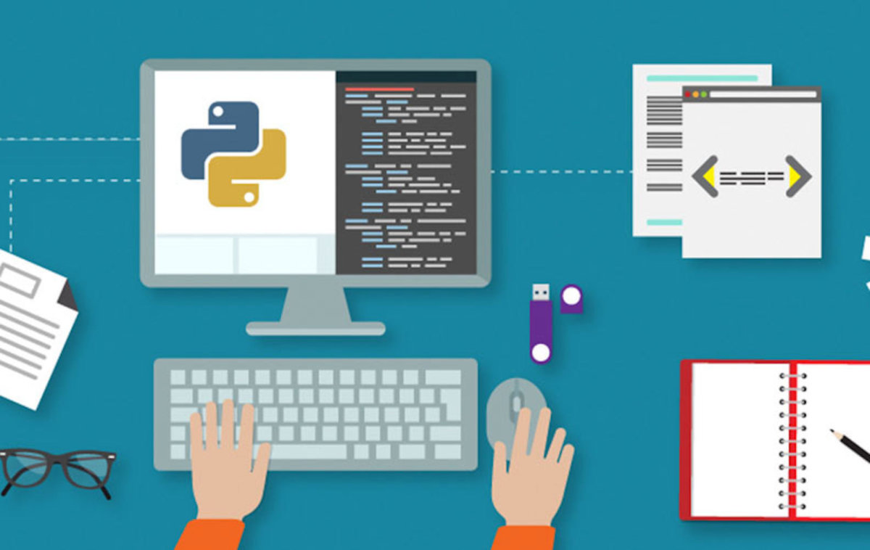
WHY LEARN PYTHON?
PYTHON IS EASY TO LEARN
PYTHON IS VERSATILE
FREE AND OPEN SOURCE

Slide 22
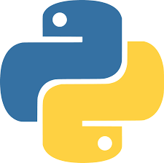
FEATURES OF PYTHON
Object Oriented Programming Language
Portable Language
GUI Programming Support
Integrated Language
Dynamically Typed

Slide 23
WHERE TO CODE?

Slide 24
1. INTEGRATED DEVELOPMENT ENVIRONNMENT(IDE) Eg – Jupyter Notebook, Pycharm , Spyder etc.
2. CODE EDITOR
Eg – Atom , Notepad++ , Sublime Text etc.

Slide 25
WHAT IS AN IDE?

Slide 26

An Integrated Development Environment (IDE)
is a software where you can write your code .
An IDE has a lot of features .
Debugger
Code Editor
Compiler
Interpreter
Syntax Highlighting
Auto Code Completion
Pre- installed packages

Slide 27
WHAT IS A CODE EDITOR?

Slide 28
CODE EDITOR
A text editor that is specialized for writing programs.
It does not provide a lot of features like an IDE

Slide 29
Installing Anaconda
Anaconda is the most widely used Python distribution for data science and comes pre-loaded with all the most popular libraries and tools .
It also provides IDEs like Jupyter Notebook , Spyder etc.
Some of the biggest Python libraries included in Anaconda include numpy, pandas, matplotlib, sklearn, seaborn etc.

Slide 30
HOW TO LEARN PYTHON FOR DATA SCIENCE?

Slide 31

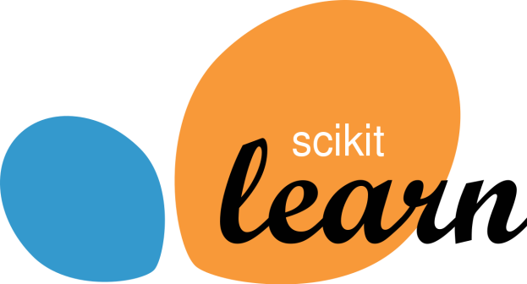


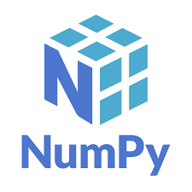


Learn Topics Related to Data Science

Slide 32
STUDY ACCORDING TO A TIMETABLE
For 2 months study 2-3 hours everyday.

Slide 33
You cannot be a wizard of python in 2 months

Slide 34
METHODS TO REMEMBER CODES

Slide 35
DON’T Cram Codes!
Understand the logic behind the code

Slide 36
CODE EVERYDAY
Practice exercises related
to the topic you are studying.

Slide 37
Learn the applications of the topic you are studying

Slide 38
REVISION OF IMPORTANT CONCEPTS EVERYDAY
Just give a glance on the important concepts(syntaxes , logical programs etc) everyday.
This will help you remember the codes.

Slide 39
GOOGLE IS YOUR FRIEND

Slide 40

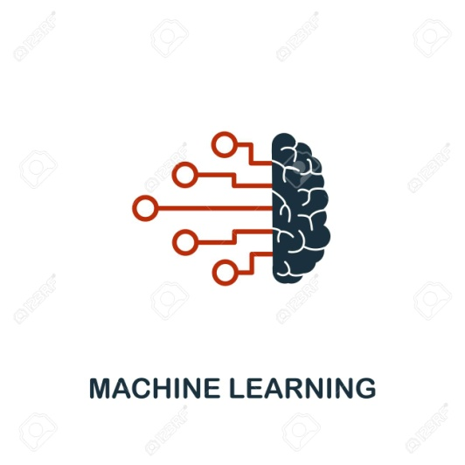
While learning python side-by-side learn Statistics and ML Concepts.
Data Science projects involve machine learning and statistical concepts.

Slide 41
ERRORS EXPERIENCE
DON’T FEEL DEMOTIVATED

Slide 42
AGE IS JUST A NUMBER

Slide 43
ROADMAP TO PYHTON

Slide 44




ROADMAP - PYTHON
PYTHON PROGRAMMING
FUDAMENTALS
FILE HANDLING AND EXCEPTION HANDLING
PYTHON BASICS
1
2
3
4
5
6
7
INTRODUCTION TO PYTHON
PYTHON DATA STRUCTURES
OBJECT ORIENTED PROGRAMMING(OOPS)
CONCEPT
NUMPY

Slide 45
ROADMAP - PYTHON
MACHINE LEARNING
WITH SCIKIT-LEARN(SKLEARN) AND OTHER LIBRARIES
DATA
VISUALIZATION
8
9
10
11
DATA MANIPULATION WITH PANDAS
STATISTICS,MATHS
WITH
SCIPY

Slide 46
THANK YOU

